Slide 1
Signal Encoding Techniques
Chapter 3

Slide 2
Reasons for Choosing Encoding Techniques
Data
Encoding
Signal
Digital data, digital signal
  Equipment less complex and expensive than digital-to-analog modulation equipment
Analog data, digital signal
  Permits use of modern digital transmission and switching equipment

Slide 3
Reasons for Choosing Encoding Techniques
Digital data, analog signal
  Some transmission media will only propagate analog signals
  E.g., optical fiber and unguided media
Analog data, analog signal
  Analog data in electrical form can be transmitted easily and cheaply
  Done with voice transmission over voice-grade lines

Slide 4
Signal Encoding Criteria
What determines how successful a receiver will be in interpreting an incoming signal?
  Signal-to-noise ratio
  Data rate
  Bandwidth
An increase in data rate increases bit error rate
An increase in SNR decreases bit error rate
An increase in bandwidth allows an increase in data rate

Slide 5
Factors Used to Compare
Encoding Schemes
Signal spectrum
  With lack of high-frequency components, less bandwidth required
  Transfer function of a channel is worse near band edges
Clocking
  Ease of determining beginning and end of each bit position

Slide 6
Factors Used to Compare
Encoding Schemes
Signal interference and noise immunity
  Performance in the presence of noise
Cost and complexity
  The higher the signal rate to achieve a given data rate, the greater the cost

Slide 7
Basic Encoding Techniques
Digital data to analog signal
  Amplitude-shift keying (ASK)
    Amplitude difference of carrier frequency
  Frequency-shift keying (FSK)
    Frequency difference near carrier frequency
  Phase-shift keying (PSK)
    Phase of carrier signal shifted

Slide 8
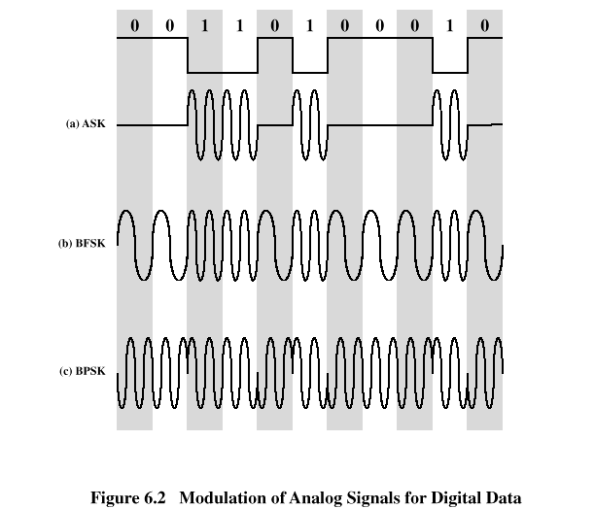
Basic Encoding Techniques

Slide 9
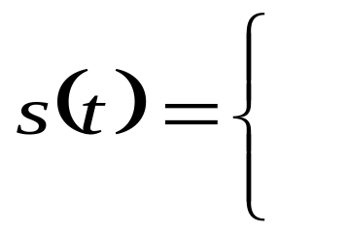
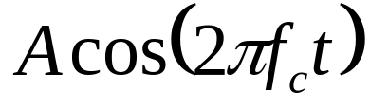
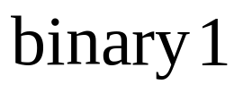

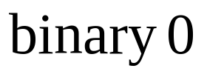
Amplitude-Shift Keying
One binary digit represented by presence of carrier, at constant amplitude
Other binary digit represented by absence of carrier
    where the carrier signal is Acos(2πf_{c}t)

Slide 10
Amplitude-Shift Keying
Susceptible to sudden gain changes
Inefficient modulation technique
On voice-grade lines, used up to 1200 bps
Used to transmit digital data over optical fiber

Slide 11
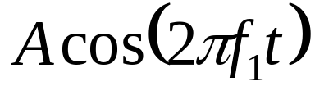
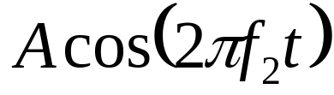
Binary Frequency-Shift Keying (BFSK)
Two binary digits represented by two different frequencies near the carrier frequency
    where f₁ and f₂ are offset from carrier frequency f_{c} by equal but opposite amounts

Slide 12
Binary Frequency-Shift Keying (BFSK)
Less susceptible to error than ASK
On voice-grade lines, used up to 1200bps
Used for high-frequency (3 to 30 MHz) radio transmission
Can be used at higher frequencies on LANs that use coaxial cable

Slide 13
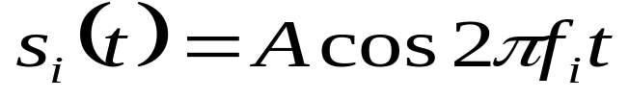

Multiple Frequency-Shift Keying (MFSK)
More than two frequencies are used
More bandwidth efficient but more susceptible to error
    f _{i} = f _{c} + (2i – 1 – M)f _{d}
    f _{c} = the carrier frequency
    f _{d} = the difference frequency
    M = number of different signal elements = 2 ^{L}
    L = number of bits per signal element

Slide 14
Multiple Frequency-Shift Keying (MFSK)
To match data rate of input bit stream, each output signal element is held for:
  T_{s}=LT seconds
    where T is the bit period (data rate = 1/T)
So, one signal element encodes L bits

Slide 15
Multiple Frequency-Shift Keying (MFSK)
Total bandwidth required
  2Mf_{d}
Minimum frequency separation required 2f_{d}=1/T_{s}
Therefore, modulator requires a bandwidth of
  W_{d}=2^{L}/LT=M/T_{s}

Slide 16
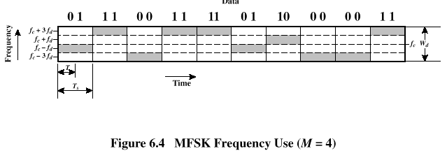
Multiple Frequency-Shift Keying (MFSK)

Slide 17
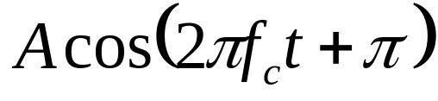
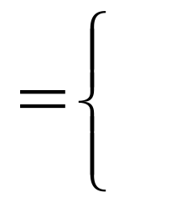
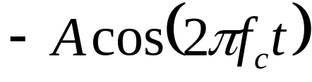
Phase-Shift Keying (PSK)
Two-level PSK (BPSK)
  Uses two phases to represent binary digits

Slide 18
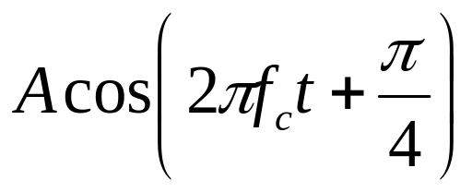
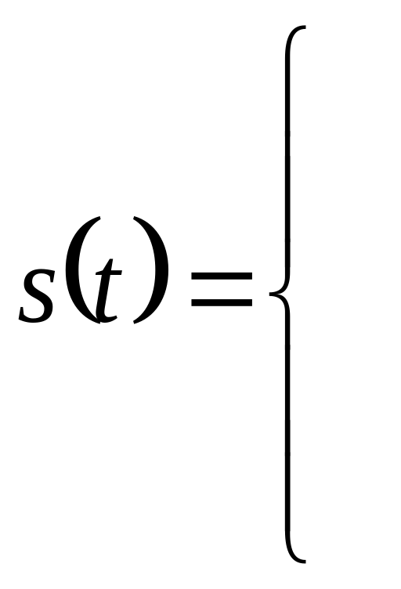

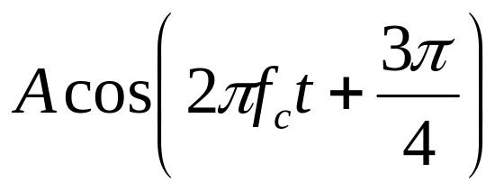

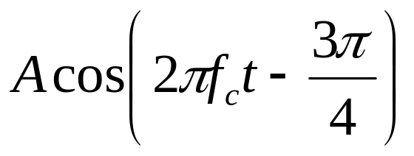

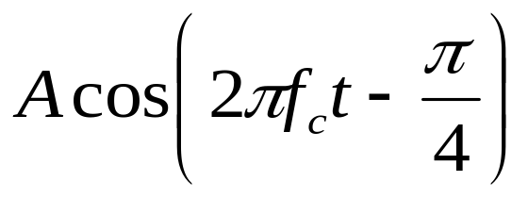

Phase-Shift Keying (PSK)
Four-level PSK (QPSK)
  Each element represents more than one bit

Slide 19
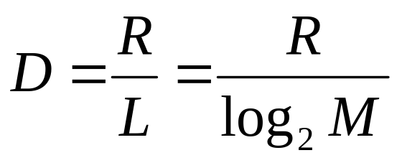
Phase-Shift Keying (PSK)
Multilevel PSK
  Using multiple phase angles with each angle having more than one amplitude, multiple signals elements can be achieved
    D = modulation rate (number of signal elements or symbols per second), baud rate
    R = data rate, bps
    M = number of different signal elements = 2^{L}
    L = number of bits per signal element

Slide 20
Performance
Bandwidth of modulated signal (B_{T})
  ASK, PSK B_{T}=(1+r)R
  FSK B_{T}=2DF+(1+r)R
    R = bit rate
    0 < r < 1; related to how signal is filtered
    DF = f₂-f_{c}=f_{c}-f₁

Slide 21
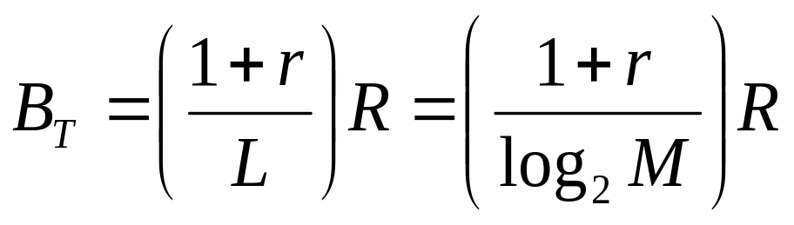
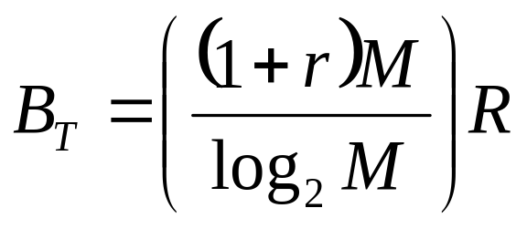
Performance
Bandwidth of modulated signal (B_{T})
  MPSK
  MFSK
    L = number of bits encoded per signal element
    M = number of different signal elements

Slide 22
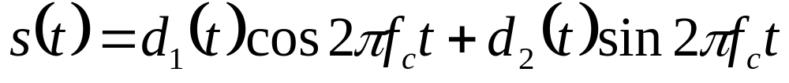
Quadrature Amplitude Modulation
QAM is a combination of ASK and PSK
  Two different signals sent simultaneously on the same carrier frequency

Slide 23
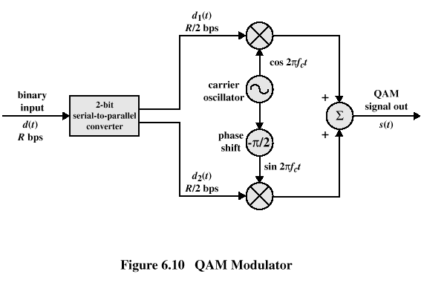
Quadrature Amplitude Modulation

Slide 24
Basic Encoding Techniques
Analog data to digital signal
  Pulse code modulation (PCM)
  Delta modulation - not covered in this course

Slide 25
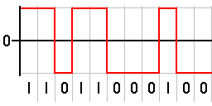
Analog Data to Digital Signal
Once analog data have been converted to digital signals, the digital data:
  can be transmitted using NRZ-L
  can be encoded as a digital signal using a code other than NRZ-L
  can be converted to an analog signal, using previously discussed techniques
NRZ-L

Slide 26
Pulse Code Modulation
Based on the sampling theorem
Each analog sample is assigned a binary code
  Analog samples are referred to as pulse amplitude modulation (PAM) samples
The digital signal consists of block of n bits, where each n-bit number is the amplitude of a PCM pulse

Slide 27
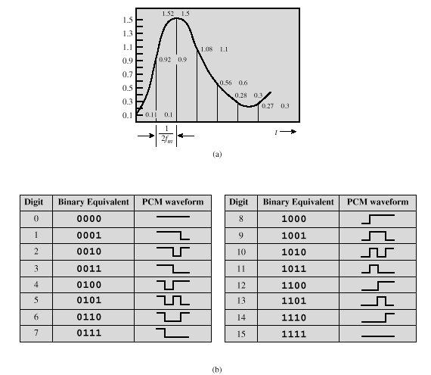
Pulse Code Modulation

Slide 28
Pulse Code Modulation
By quantizing the PAM pulse, original signal is only approximated
Leads to quantizing noise
Signal-to-noise ratio for quantizing noise
Thus, each additional bit increases SNR by 6 dB, or a factor of 4

Slide 29
Reasons for Growth of Digital Techniques
Growth in popularity of digital techniques for sending analog data
  Repeaters are used instead of amplifiers
    No additive noise
  TDM is used instead of FDM
    No intermodulation noise
  Conversion to digital signaling allows use of more efficient digital switching techniques

